Slide 1



PGAGENT
ENHANCEMENT
IITM PRAVARTAK TECHNOLOGIES
NAME OF PROJECT:
PRESENTED BY:
Enhancement of pgAgent Features
DEEPAK S B22CSB31
MUHZIN MOHAMMED B22CSB49

Slide 2


CONTENTS
Introduction
Core Functionalities
Problem Statement
System Features
Architecture and Interfaces
Test Plan
Timeline
03
14
04
17
05
20
07

Slide 3
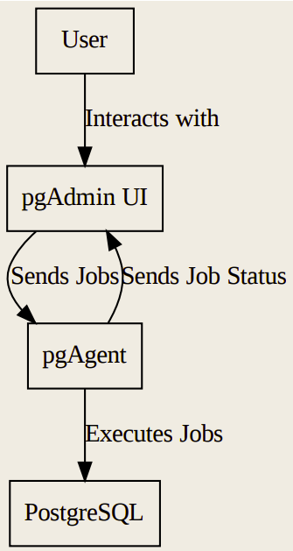
INTRODUCTION
03/21
pgAdmin is a popular open-source graphical interface for PostgreSQL.
pgAgent is a job scheduler for PostgreSQL used to automate tasks such as backups, data imports, and maintenance.
Current features lack real-time monitoring of job status and offer only basic scheduling.
This project aims to enhance these functionalities by introducing advanced scheduling and real-time job monitoring.

Slide 4

04/21
CORE FUNCTIONALITIES
Advanced Job Scheduling
Real-Time Job Monitoring
Introduce priority-based execution
.
Support for recurring, conditional, and dependent jobs.
Live updates for job execution status.
Reduce the need for manual intervention.

Slide 5

05/21
EXISTING
PROBLEMS
LACK OF REAL-TIME JOB MONITORING
BASIC SCHEDULING MECHANISM
POOR ERROR HANDLING & NOTIFICATIONS
Users must manually refresh the job status page.
Delays in status updates, leading to potential gaps in job tracking.
No progress indicators like percentage completion or live updates during execution.
No Support for Advanced Recurring Patterns .( eg : Cannot schedule jobs for every third Monday or last Friday of the month.)
No preview of next scheduled runs, leading to uncertainty in execution.
Timezone mismatches can cause incorrect execution times.
Users must manually check logs for failures.
No automated alerts for job failures or delays.
Missed job executions, affecting critical database operations.

Slide 6

POSSIBLE
ENHANCEMENTS

Slide 7
07/21
Flexible Recurrence Patterns
Multiple Time Slots per Day
Conditional Execution
Support scheduling jobs based on more complex rules, such as â€œevery third Monday of the monthâ€ or â€œevery last Friday of the quarter.â€
Allow users to define multiple execution times within a single schedule (e.g., running a job at 10 AM, 2 PM, and 6 PM on the same day).
Enable jobs to execute only if certain conditions are met, such as database state, workload metrics, or external triggers.
Live Execution Updates
Error Handling & Alerts
Job Queue Monitoring
Display real-time job progress in the pgAdmin interface, showing which step is currently executing.
Provide instant error notifications if a job fails, with detailed error messages and logs.
Show queued, running, and completed jobs in real-time, helping users manage execution priorities efficiently.

Slide 8
SYSTEM
FEATURES

Slide 9
REAL-TIME JOB STATUS
09/21
FUNCTIONAL REQUIREMENTS
LIVE JOB STATUS
HIGH
ERROR HIGHLIGHTING
HIGH
PROGRESS INDICATOR
MEDIUM
Users can view job progress without manual refresh.
Ensures better visibility and control over scheduled tasks.
Helps in quick identification of delays or stuck processes.
The system will detect and highlight errors in the interface.
Provides detailed logs to assist in troubleshooting.
Allows faster corrective action to minimize job failures.
The interface will show progress in percentage for each job.
Helps users estimate time remaining for job completion.
Useful for monitoring long-running processes.
FR-1
FR-2
FR-3

Slide 10
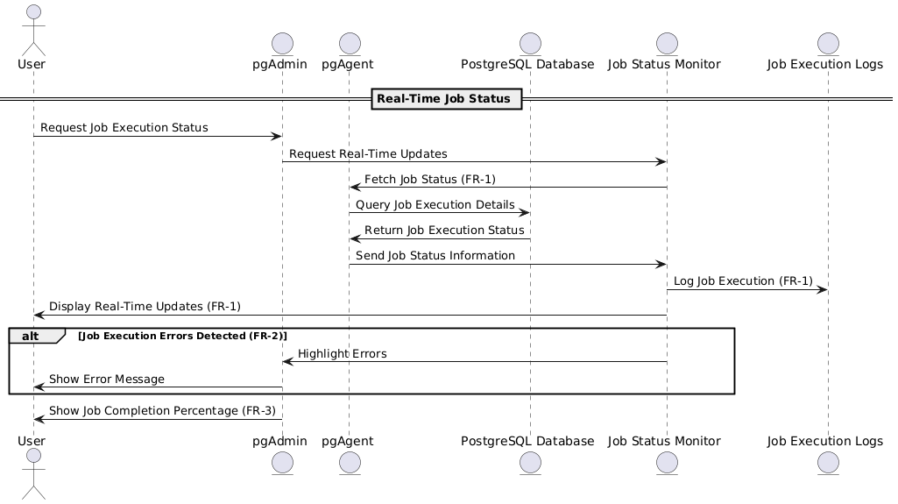

Slide 11
ADVANCED
SCHEDULING OPTIONS
11/21
FUNCTIONAL REQUIREMENTS
CUSTOM PATTERNS
HIGH
SCHEDULE PREVIEW
MEDIUM
TIMEZONE SUPPORT
MEDIUM
Users can define custom execution schedules based on specific needs.
Supports flexible scheduling options including daily, weekly, monthly, or cron-based schedules.
Enhances efficiency by automating complex job workflows.
The system provides a real-time preview of upcoming job execution times.
Helps users verify schedules before applying them.
Ensures better planning and coordination of database tasks.
Supports job scheduling across different time zones.
Automatically adjusts execution times based on the selected timezone.
Prevents timing errors due to daylight saving changes.
FR-4
FR-5
FR-6

Slide 12
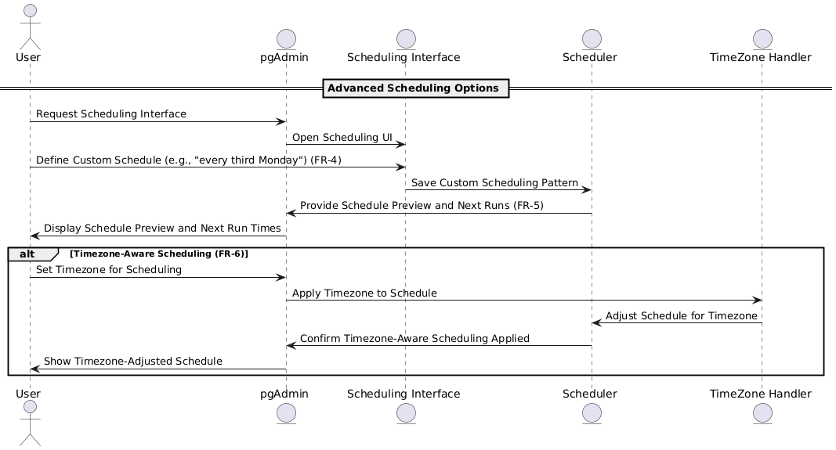

Slide 13


13/21
Performance
1
The system must not slow down the database during real-time updates.
Job monitoring should run efficiently without affecting responsiveness.
NON FUNCTIONAL
Scalability
REQUIREMENTS
2
Must support large workloads with many scheduled jobs.
Should be able to scale as job volume increases.
Security
31
Uses AES-256 encryption for stored data and TLS 1.2+ for secure communication.
Ensures confidentiality of job details and sensitive information.
Availability
4
Must maintain 99.9% uptime for continuous job scheduling and monitoring.
Ensures reliability, especially for critical production tasks.

Slide 14
SYSTEM
ARCHITECTURE & INTERFACES

Slide 15

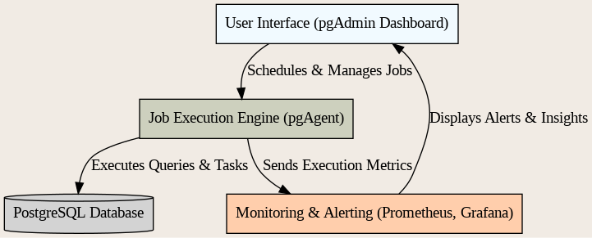

SYSTEM ARCHITECTURE OVERVIEW
15/21
User Interface (UI)
Job Execution Engine
Monitoring & Alerting
The pgAdmin dashboard provides a visual representation of job statuses and allows users to configure and manage schedules.
The pgAgent handles job scheduling and execution in PostgreSQL.
Integrates with Prometheus & Grafana for real-time job monitoring and alerts.

Slide 16
HARDWARE INTERFACES
SOFTWARE INTERFACES
16/21
Multi-core CPUs for parallel processing and faster execution.
High-memory servers to support scalability and performance in enterprise environments.
PostgreSQL 14+: Core relational database for job scheduling and execution.
pgAdmin 4: GUI for managing and tracking job execution.
pgAgent: Responsible for advanced job scheduling and execution.
External Monitoring Systems: Prometheus & Grafana for real-time job monitoring.
Database Extensions: pg_stat_statements for query performance optimization.
COMMUNICATION INTERFACES
Data Encryption: AES-256 encryption for securing stored and transmitted data.
Alerting & Notifications: Supports email, SMS, and webhooks for job execution alerts.
REST APIs: Exposes REST APIs for integration with monitoring & alerting tools.

Slide 17
TEST PLAN

Slide 18
18/21
TESTING
STRATEGY
FUNCTIONAL TESTING
PERFORMANCE TESTING
Verifies real-time job updates, scheduling, and UI interactions.
Ensures all features work as expected..
Tests system response under high job loads.
Ensures real-time monitoring doesn’t affect database performance.
SECURITY TESTING
COMPATIBILITY TESTING
Validates encryption (AES-256, TLS 1.2+) and data confidentiality.
Checks access control and authentication mechanism
Ensures the system works across different PostgreSQL versions and time zones.
Tests integration with monitoring tools like Prometheus & Grafana.

Slide 19
19/21
TEST CASES
Test Case ID | Test Case Description | Expected Outcome | Status
TC-1 | Check if a scheduled job appears in the UI. | The scheduled job should appear in the user interface. | Pending
TC-2 | Verify if job execution status updates in real time. | Job execution status should update dynamically in real-time. | Pending
TC-3 | Validate custom scheduling options. | Custom scheduling options should work as intended. | Pending
TC-4 | Test system response when scheduling conflicts occur. | The system should handle conflicts and display appropriate messages. | Pending
TC-5 | Check time zone compatibility for scheduled jobs. | Jobs should be scheduled accurately across different time zones. | Pending

Slide 20



20/21
Timeline
Phase 1
Phase 2
Phase 3
Phase 4
Requirements Gathering and Analysis
Real-Time Monitoring Implementation
Advanced Scheduling Feature Development
System Testing and Optimization

Slide 21

THANK
YOU

